Slide 1



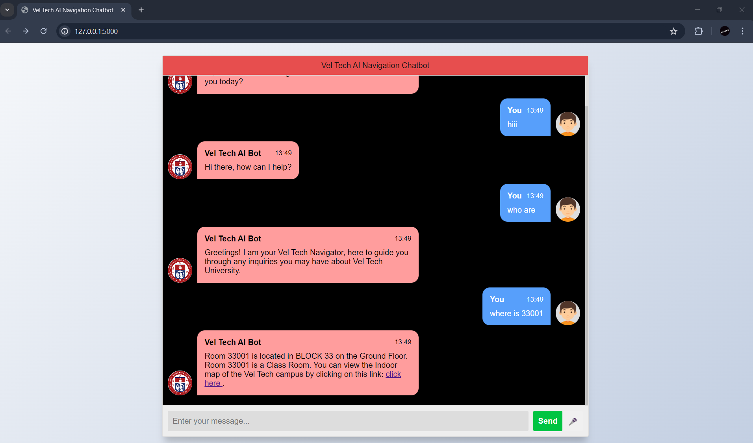
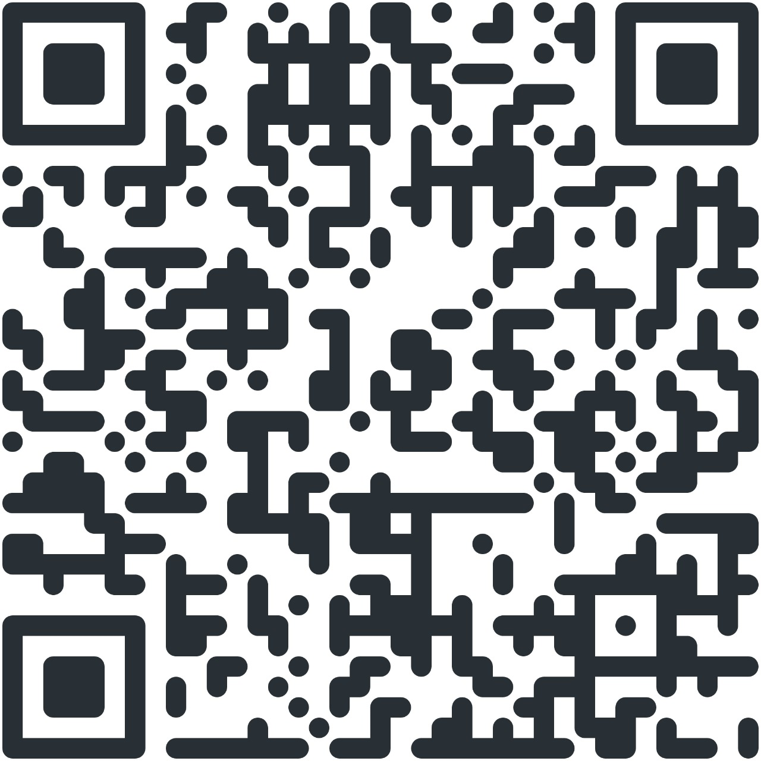
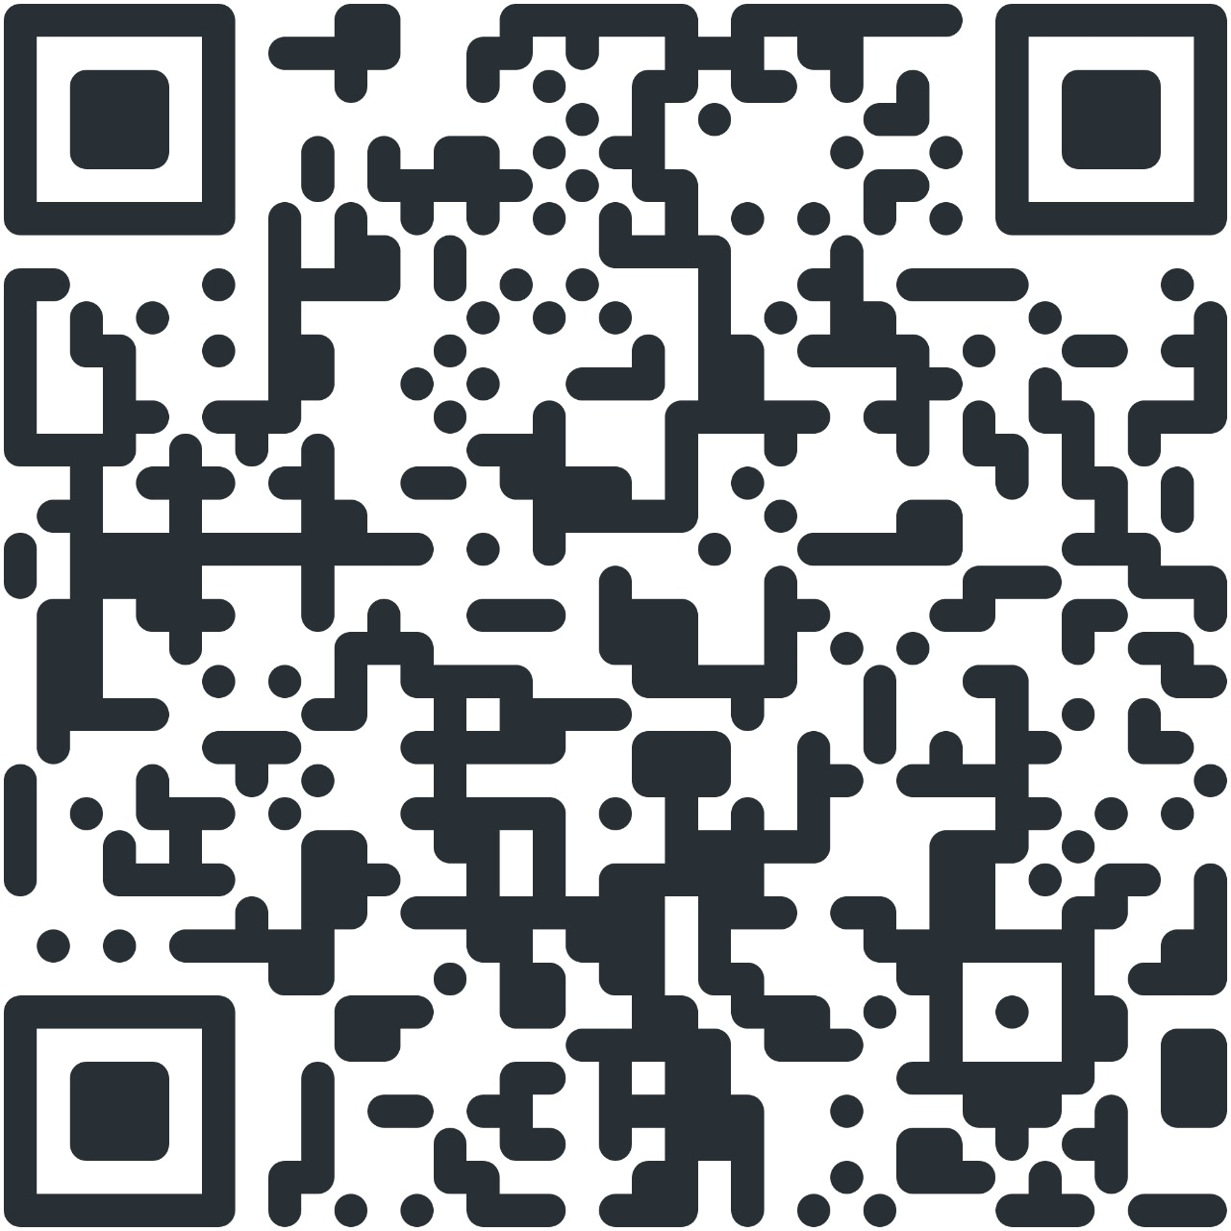
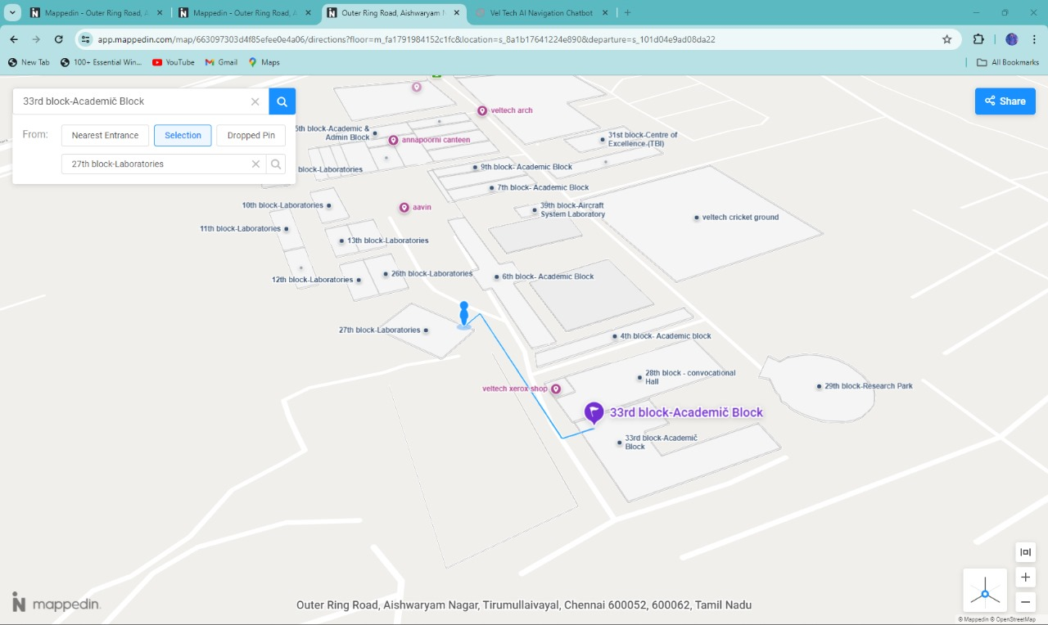
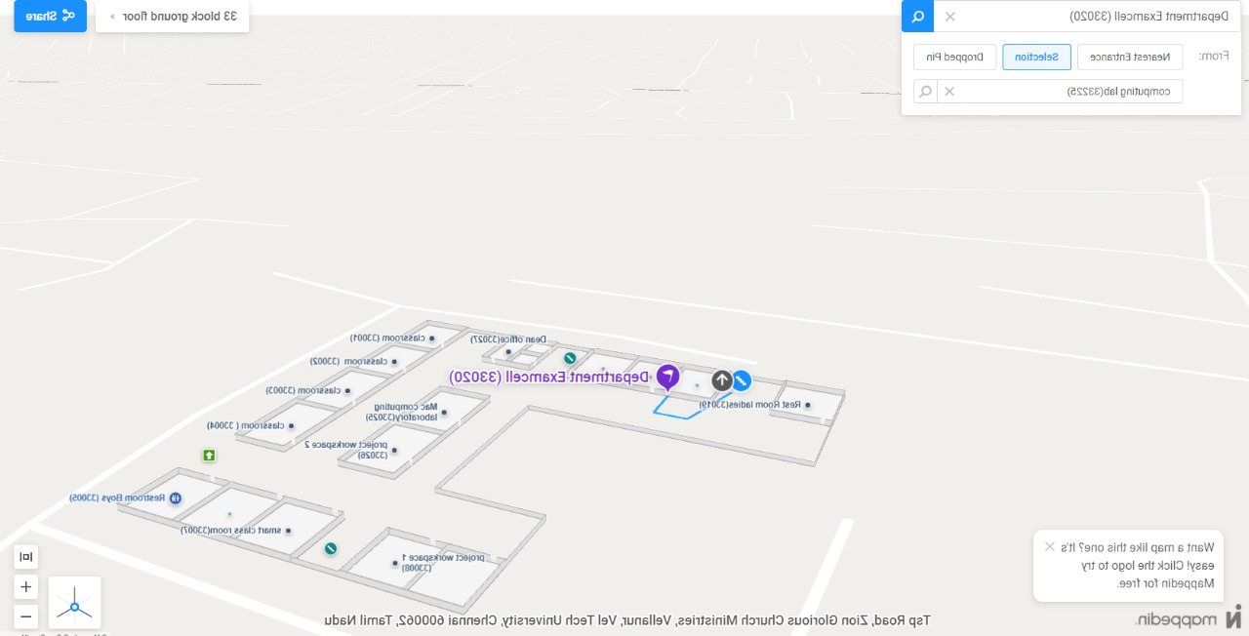
AI NAVIGATIONAL CHATBOT
School of Computing
Department of Artificial Intelligence & Data Science
10214AD602– MINOR PROJECT-II
WINTER SEMESTER 2023-2024
ABSTRACT
INTRODUCTION
RESULTS
STANDARDS AND POLICIES
In the modern era of digital advancement, the integration of artificial intelligence (AI) into various aspects of daily life has become increasingly prevalent. One such area where AI holds significant potential is in the realm of campus navigation systems for colleges and universities. This project introduces a comprehensive AI navigational chatbot designed specifically for college campuses, aimed at revolutionizing the way individuals navigate and interact with their educational environments. The proposed AI navigational chatbot serves as a multifaceted solution to address the complexities and challenges associated with campus navigation.
The efficiency of the proposed AI navigational chatbot system depends on its approach to address navigational challenges. It demonstrates remarkable efficiency in revolutionizing the navigation experience for students, faculty, staff, and visitors alike. By harnessing the power of artificial intelligence, real-time data integration, and personalized assistance, the system streamlines navigation processes, minimizes time wastage, and enhances overall user satisfaction.
The efficiency of the proposed AI navigational system lies in its ability to streamline navigation processes, provide personalized assistance, and adapt to dynamic campus conditions. By leveraging cutting-edge technology and seamless integration with campus infrastructure, the system transforms the navigation experience, making it more convenient, efficient, and user-friendly for all members of the campus community
In implementing AI navigational chatbots for campus environments, several standards and policies ensure their effectiveness, security, and compliance with institutional guidelines. Accessibility standards, such as WCAG (Web Content Accessibility Guidelines), ensure that the chatbot interface is usable by individuals with disabilities, providing equal access to information and services. Privacy policies dictate how user data is collected, stored, and used, adhering to regulations like GDPR (General Data Protection Regulation) or CCPA (California Consumer Privacy Act) to safeguard user privacy. Security protocols, including encryption, authentication, and authorization mechanisms, protect sensitive information exchanged during interactions with the chatbot. Additionally, adherence to institutional branding guidelines ensures consistency in visual design and messaging, fostering trust and recognition among campus users. Compliance with industry standards and best practices, coupled with regular audits and reviews, ensures that the AI navigational chatbot meets the evolving needs and requirements of the campus community while upholding high standards of quality, security, and accessibility.
In an era defined by rapid technological advancement, the integration of artificial intelligence (AI) has transformed various facets of our daily lives. One domain where AI has shown immense promise is in the realm of campus navigation systems for educational institutions. Navigating sprawling college campuses, with their labyrinthine networks of buildings, pathways, and amenities, can often be a daunting task for students, faculty, staff, and visitors alike. Traditional methods of navigation, such as paper maps or static online directories, often fall short in providing the real-time, personalized guidance needed to navigate modern college environments effectively. To address these challenges and enhance the campus navigation experience, we propose the development and implementation of an AI navigational chatbot tailored specifically for college campuses. This innovative solution harnesses the power of AI and natural language processing (NLP) technologies to provide users with an intuitive and interactive platform for navigating their educational environments
By leveraging the power of AI to enhance accessibility, convenience, and personalized assistance, the chatbot stands poised to become an indispensable tool for students, faculty, staff, and visitors alike, ushering in a new era of intelligent campus navigation.
Figure 1. Chatbot Implementation
Figure 3.QR codes
CONCLUSIONS
METHODOLOGIES
The AI navigational chatbot represents a game-changing solution for improving campus navigation and user experience in educational institutions. As technology continues to evolve and innovation progresses, the potential for the AI navigational chatbot to transform the campus experience remains limitless, promising a future of enhanced connectivity, accessibility, and convenience for all members of the campus community.
TEAM MEMBER DETAILS
Developing an AI navigational chatbot entails employing various methodologies to ensure smooth interaction and effective guidance for users. User-Center Design (UCD) forms the foundation, where understanding user needs and behaviours through research drives interface and conversation design. Information Architecture (IA) plays a pivotal role in organizing content hierarchically, facilitating seamless navigation. Dialog Design focuses on crafting engaging conversations, leveraging personas and scenarios to create contextually relevant interactions. Machine Learning and Natural Language Processing (NLP) techniques are essential for understanding user queries, providing accurate responses, and adapting to user inputs over time, enhancing the chatbot's navigational capabilities.
PATAN YASEEN (20325)
JUHI CHAUDHARY (19364)
P. JEEVAN KUMAR REDDY (18978)
9959873786
9311122400
9963790406
vtu20325@veltech.edu.in
vtu19364@veltech.edu.in
vtu18978@veltech.edu.in
ACKNOWLEDGEMENT
Dr.D.Rajesh
9688805797
rajesh@veltech.edu.in
.
Figure 2. Navigation Implementation

